Slide 1
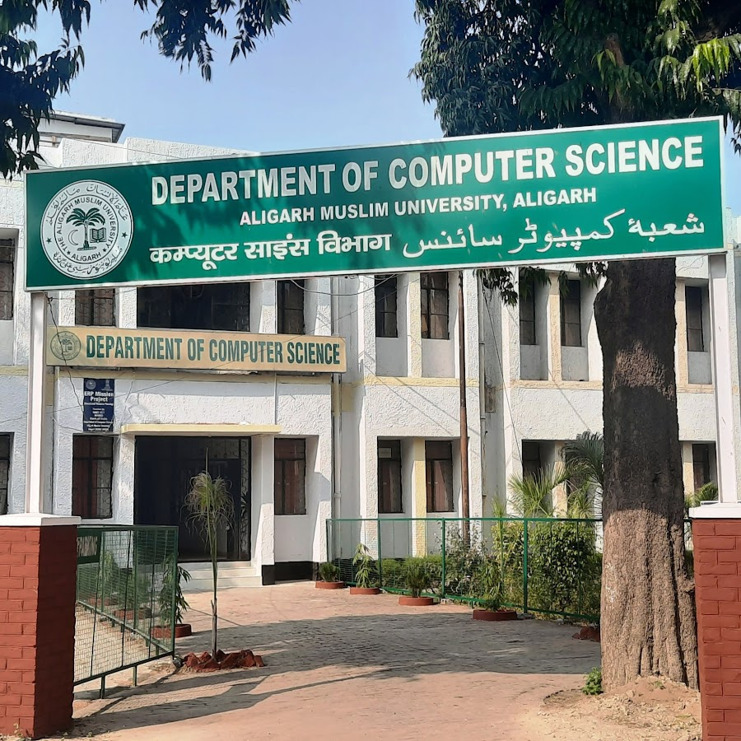
Department of Computer Science Presents
IT FEST 2025
Open to all students of the Computer Science Department!
For Register Visit:
Date: 20 August 2025
Time: 10:00 AM – 5:00 PM
Venue: Department of computer science, AMU
Highlights Section:
Coding Challenges
Tech Quiz
Guest Talks
Prizes & Certificates

